Slide 1


TalkTech
A vision to the future.
Your logo

Slide 2
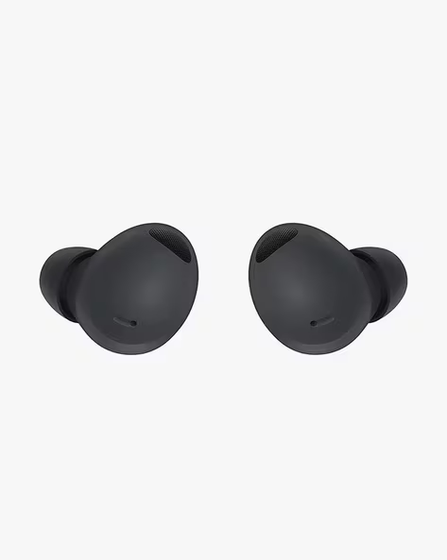


MAIN PROJECT
MAIN GOAL
Real-Time Translation tech Added Functions
Global Inclusivity (Even elderly population.)
Artificial Intelligence Assistant & Easy connectivity.
Custom Made & Best Material Quality.
Concerned about environment.

Slide 3
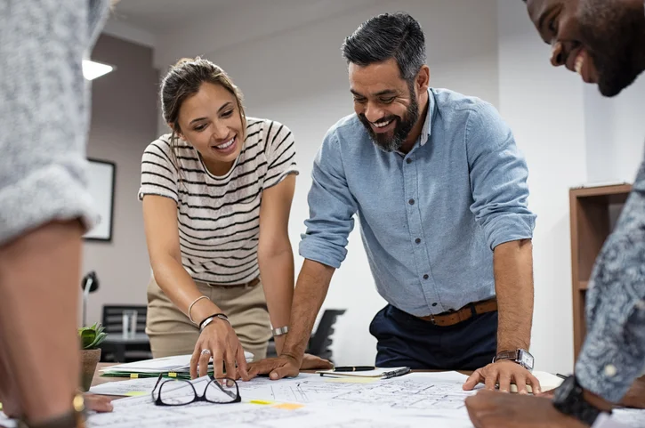
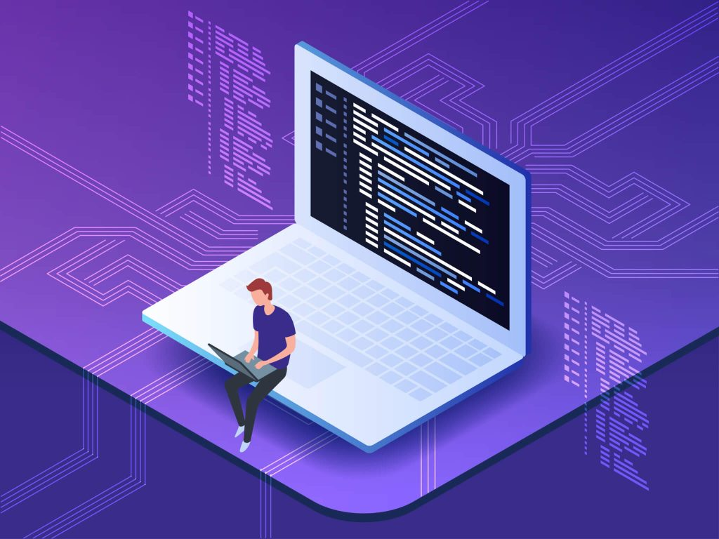
Lead Engineer
Leads all the related technical development
Most important piece for the earbud creation.
Constant improvement (Updates…)
Fixes all the issues (testing…)
AI Implementation.

Slide 4
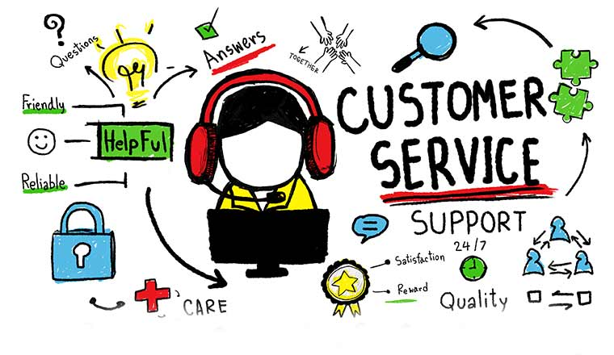
Customer Support Representative
📞 Customer Service
💬 Communication
🔧 Technical Support
📊 Feedback Collection
🤝 Empathy and Patience

Slide 5

Product Manager
Define Product Vision
Gather User Feedback
Coordinate all aspects related to the product.
Make decisions about the final product
Give the final check to the design

Slide 6

UI Designer (Daniel Ibáñez)
Simplicity
Clear design
Accessibility
Customization
Notes:
1. Simplicity - The interface needs to be simple because users want to focus on the conversation.
2. Clear design- We use clear icons and simple text.
3. Accessibility-The app should work for everyone, including people with disabilities.
4. Customization-Users can also customize their experience, such as changing the speed of the translation or choosing the voice that speaks the translated language.

Slide 7

Marketing Specialist // Objectives
Position TalkTech as a leader in translation headphones.
Target campaigns for key audiences.
Boost sales through ad campaigns.
Create content showing product benefits.
Enhance customer support and retention.
Improve online presence and conversions.

